Slide 1

Lifestyle Factors & Health Outcomes: An MLP Regression Approach
Garrett Francis
CSC422
30 November 2025

Slide 2
Background
Social media has promoted a lot of misinformation on health
Causes people to stress over the wrong things
66% of Americans reported being anxious about their health

Slide 3
Dataset & Prediction Task
Data set from Kaggle
Features: Diet Quality, BMI, Exercise Frequency, Sleep Hours, Age, Smoking Status, Alcohol Consumption
Goal: Predict a health score from lifestyle variables

Slide 4
Workflow
Data
Feature Engineering
Preprocessing
Training
Evaluation

Slide 5
Baseline model
Linear regression model
R² = .81, MAE = 4.6, RMSE = 5.6

Slide 6

MLP Model
MLPRegressor with 3 hidden layers
Used a CV search for tuning
Evaluation metrics: MAE, RMSE, R²
Notes:
Demonstrate model

Slide 7
Ensemble Model
Weighted MLPRegressor + LightGBM model
85% MLP / 15% LightGBM
LightGBM model captures relationships that MLP doesn’t

Slide 8

Findings

Slide 9
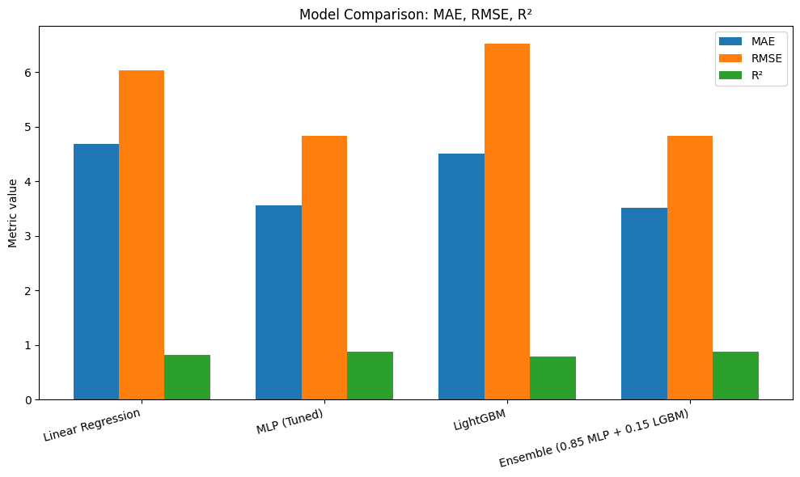
Model Comparison

Slide 10
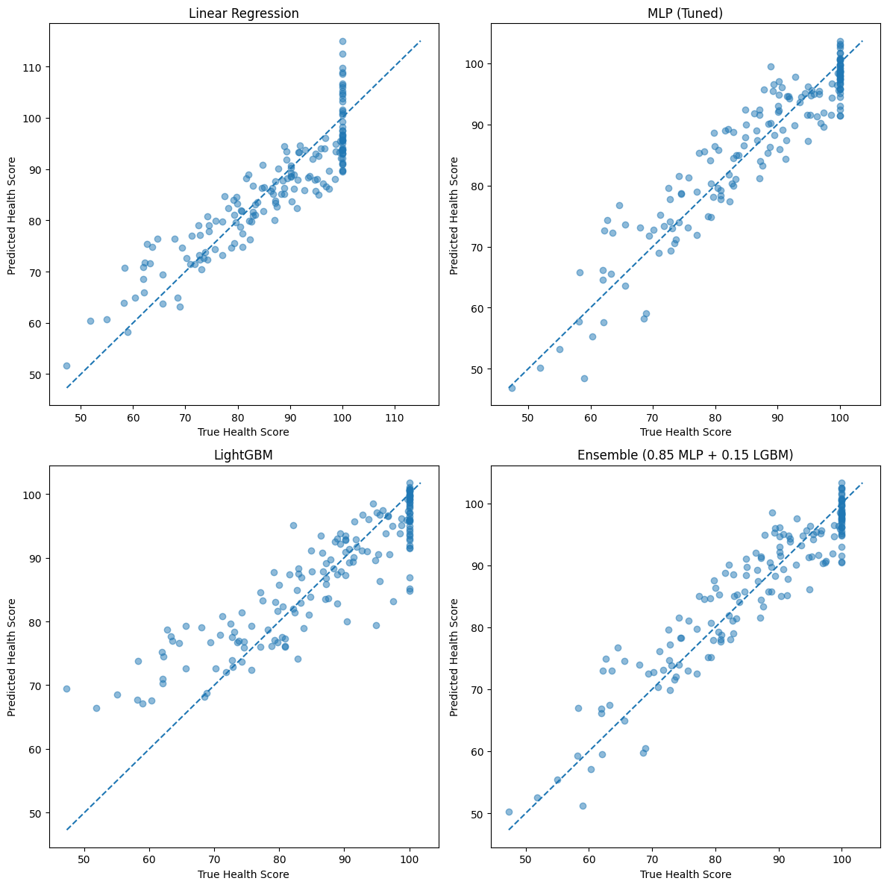
Predicted vs. True for all Models

Slide 11
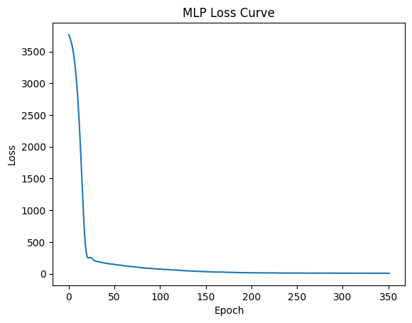
MLP Loss Curve

Slide 12
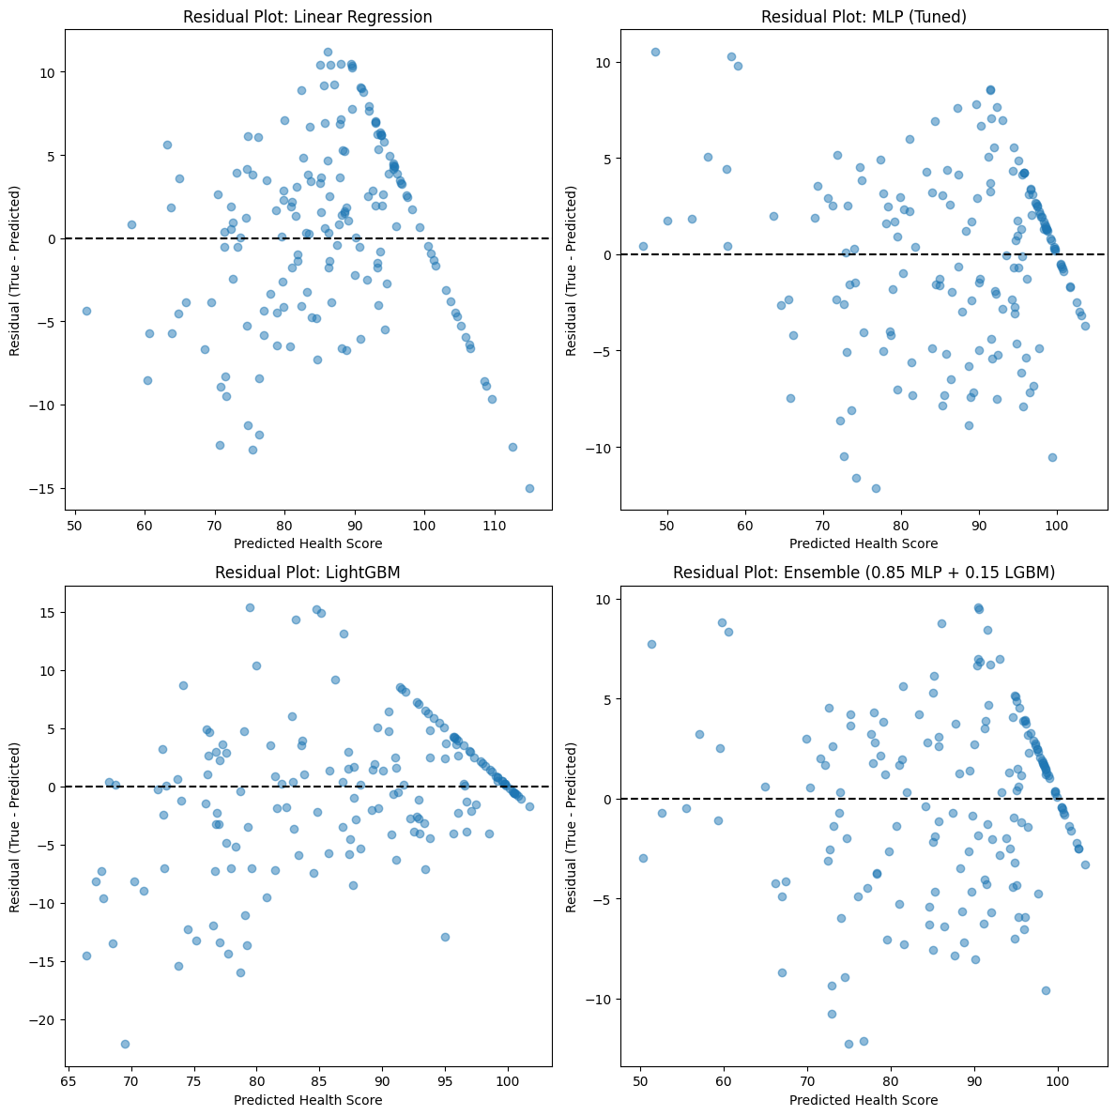
Residual Plots for all Models

Slide 13
Conclusion
Contributions:
Created a model that beats baseline and can fairly accurately predict health scores
Used feature engineering to increase model performance
Implemented a MLP with a CV search for maximum performance
Future Work:
Improve feature engineering
Get better data

Slide 14
Questions?

